Slide 1
Extending the MOC-UI
Team Member: Thomas Hsu, William Vangos, Alex Wong, Hang Xu
Project Mentor: Jon Bell

Slide 2
MOC-UI Recap
A user interface for the Massachusetts Open Cloud, a collaboration between universities in the Boston area.
We seek to develop a dynamic marketplace and provide a friendlier user experience than the Horizon UI

Slide 3
The New UI
Reworked HTML into a center panel, contains reusable modals and forms
All of the views have been replaced
Login page authenticates with a local database instead of Keystone
Can span across multiple OpenStack installations

Slide 4
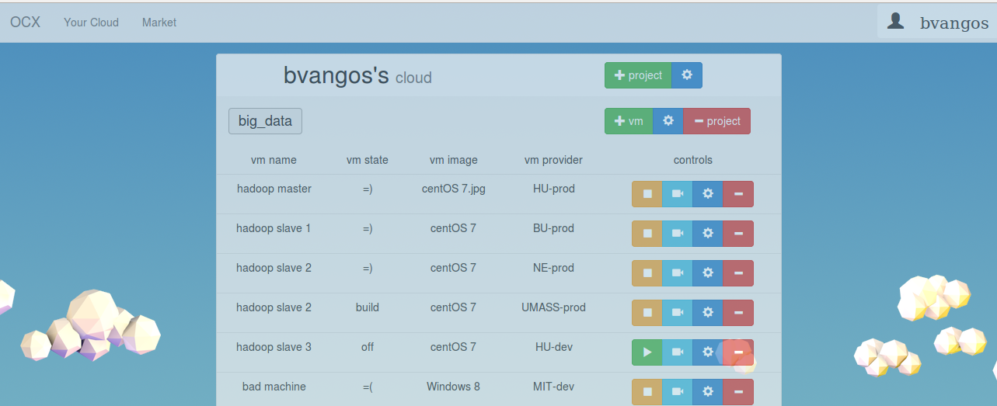

Slide 5
Over Sprint 2
Familiarization with the new UI
Created and designed the marketplace page
Created a “Users” page

Slide 6
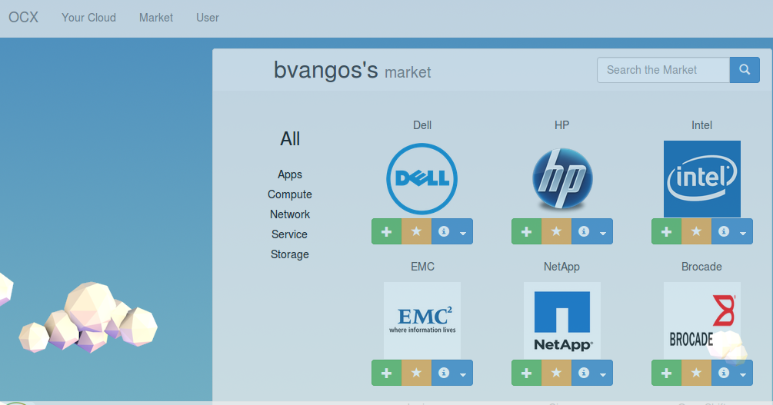

Slide 7
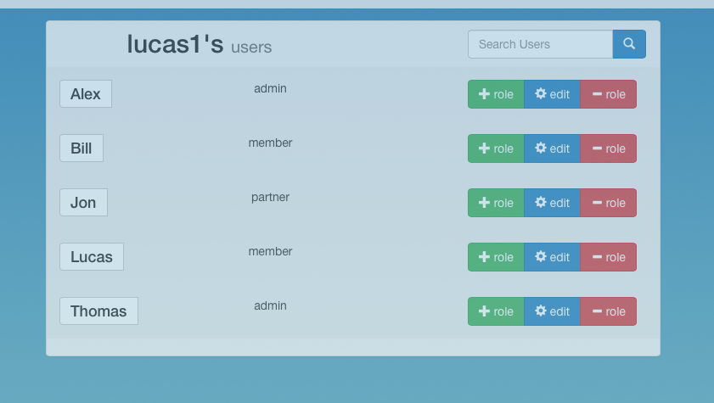

Slide 8
Demo

Slide 9
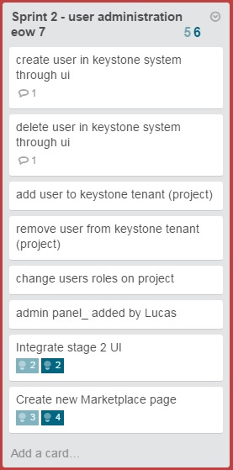
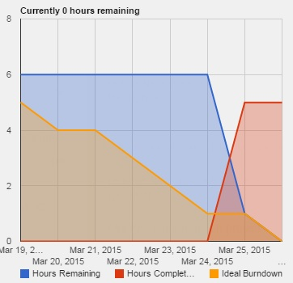
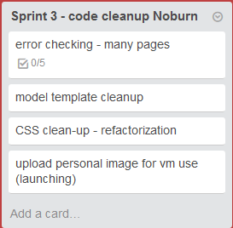
Trello

Slide 10
Thanks

